Slide 1
Mass-Storage Structure

Slide 2
Secendory Storage Management
Why secondary storage?
main memory too small
main memory volatile
Devices: Disks, Tapes, Drums
Disks are critical components
  For virtual memory management
  Storing files
Disk technology hasn’t changed much compared to processor technology (esp., speed)

Slide 3
Outline
Disk Structure
Disk Scheduling
Disk Management
Swap-Space Management
RAID Structure
Disk Attachment
Stable-Storage Implementation
Tertiary Storage Devices

Slide 4

Moving-head Disk Machanism

Slide 5
Overview of Mass Storage Structure
Magnetic disks provide bulk of secondary storage of modern computers
  Drives rotate at 60 to 200 times per second
  Transfer rate is rate at which data flow between drive and computer
  Positioning time (random-access time) is time to move disk arm to desired cylinder (seek time) and time for desired sector to rotate under the disk head (rotational latency)
  Head crash results from disk head making contact with the disk surface
    That’s bad
Disks can be removable
Drive attached to computer via I/O bus
  Busses vary, including EIDE, ATA, SATA, USB, Fibre Channel, SCSI
  Host controller in computer uses bus to talk to disk controller built into drive or storage array

Slide 6
Disk Structure
Disk drives are addressed as large 1-dimensional arrays of logical blocks, where the logical block is the smallest unit of transfer.
The 1-dimensional array of logical blocks is mapped into the sectors of the disk sequentially.
  Sector 0 is the first sector of the first track on the outermost cylinder.
  Mapping proceeds → (Cylinder, Track, Sector)
    In practice, not always possible
      Defective Sectors
      # of tracks per cylinders is not a constant

Slide 7
Disk Scheduling

Slide 8
Overview
OS is responsible for using hardware efficiently
  For disk drives → fast access time and disk bandwidth
Access time has two major components
  Seek time is the time for the disk to move the heads to the cylinder containing the desired sector
    Seek time ≈ seek distance
    Minimize seek time
  Rotational latency is the additional time waiting for the disk to rotate the desired sector to the disk head
    Difficult for OS
Disk bandwidth is the total number of bytes transferred, divided by the total time between the first request for service and the completion of the last transfer

Slide 9
Overview (Cont.)
Several algorithms exist to schedule the servicing of disk I/O requests.
We illustrate them with a request queue (0-199).
  98, 183, 37, 122, 14, 124, 65, 67
  Head pointer 53

Slide 10

FCFS
Illustration shows total head movement of 640 cylinders.

Slide 11
FCFS
Advantage
  Easy to understand and implement (queue)
  No Starvation (many suffer from convey effect)
  Can be used with less load
Disadvantage
  Require more Seek time
  More waiting time and response time
  Inefficient

Slide 12
SSTF
Shortest-Seek-Time First (SSTF)
Selects the request with the minimum seek time from the current head position.
SSTF scheduling is a form of SJF scheduling; may cause starvation of some requests.
  Remember that requests may arrive at any time
Not always optimal (how about 53→37→14→65…)

Slide 13

SSTF (Cont.)
Illustration shows total head movement of 236 cylinders.

Slide 14
SSTF (Cont.)
Advantage
  Very efficientt in seek moves
  Increased throughput
  Disadvantage
  Overhead to find out closest request
  Request far from head, will starve
  High variance in waiting time and response time

Slide 15
SCAN
The disk arm starts at one end of the disk, and moves toward the other end, servicing requests until it gets to the other end of the disk, where the head movement is reversed and servicing continues.
Sometimes called the elevator algorithm.

Slide 16
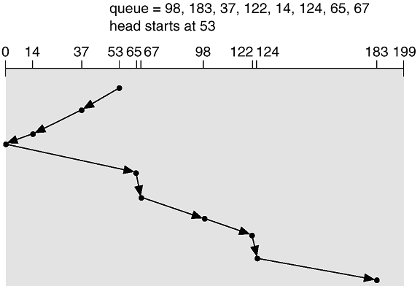
SCAN (Cont.)
Say Head movement direction is towards 0
Illustration shows total head movement of 236 cylinders.

Slide 17
SCAN (Cont.)
Advantage
  Simple easy to understand and implement
  No Starvation (bounded waiting time)
  Disadvantage
  Unnecessary mobile time till the end of the disk, even there is no request
  Longer waiting time for requesting just visited by head

Slide 18
C-SCAN
Provides a more uniform wait time than SCAN.
The head moves from one end of the disk to the other, servicing requests as it goes. When it reaches the other end, however, it immediately returns to the beginning of the disk, without servicing any requests on the return trip.
Treats the cylinders as a circular list that wraps around from the last cylinder to the first one.

Slide 19

C-SCAN (Cont.)
Say Head movement direction is towards 199

Slide 20
C-SCAN (Cont.)
Advantage
  Provide uniform waiting time
  Better response time
Disadvantage
  More seek movements compare to simple SCAN.

Slide 21
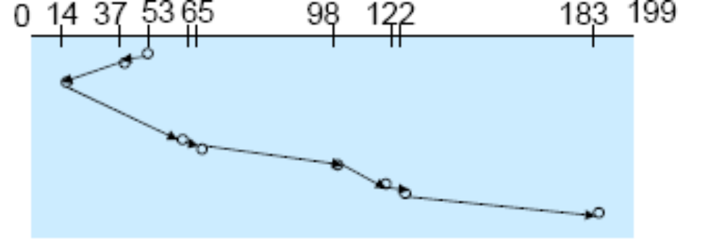

LOOK Scheduling
Look Scheduling
Similar with Scan scheduling, but the disk arm only goes as far as the final request in each direction
For example, a disk queue with requests for I/O to sectors on cylinders

Slide 22
C-LOOK
Version of C-SCAN
Arm only goes as far as the last request in each direction, then reverses direction immediately, without first going all the way to the end of the disk.

Slide 23

C-LOOK (Cont.)

Slide 24
Selecting a Disk-Scheduling Algorithm
SSTF is common and has a natural appeal
SCAN and C-SCAN perform better for systems that place a heavy load on the disk
  Remove starvation problem
Performance relies on the number and types of requests
Requests for disk service can be influenced by the file-allocation method (Contiguous? Linked or Indexed?)
Directory location and index blocks positions
  separate module of Disk Scheduling in the operating system,
    replaceable
Either SSTF or LOOK is a reasonable choice for the default algorithm
Scheduled by OS? Scheduled by disk controller?

Slide 25
Disk Management

Slide 26
Disk Formatting
Typical sector is 512 bytes
  Preamble identifying start code and sector address
  Data
  Error correction code (16 bits). At least detecting errors possible with probability almost 1
Cylinder skew:
  After reading an entire track, as head is moved across a cylinder, seeking next sector shouldn’t cause waiting for full rotation
Interleaving sectors:
As a sector is copied into controller buffer, it needs to be copied into main memory. So next sector should not be adjacent if we wish to avoid waiting for one full rotation

Slide 27
Disk Partition
To use a disk to hold files, OS still needs to record its own data structures on the disk. it does so in two steps
Partition the disk into one or more groups of cylinders
  Each partition can be treated as a separate disk
  After partitioning , the second step is:
Logical formatting or “making a file system”
  Store the initial file-system data structure onto the disk:
    Maps of free and allocated space (FAT or inode)
    Initial empty directory

Slide 28
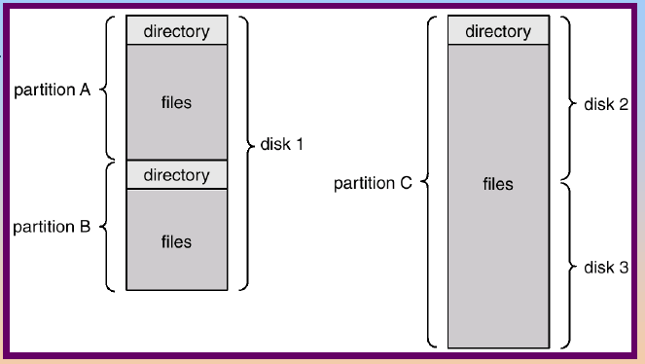
A Typical File-System Organization

Slide 29
Boot Block
Boot block initializes system
  Initialize CPU registers, device controllers, main memory
  Start OS
A tiny bootstrap loader is stored in boot ROM
  Bring a full bootstrap program from disk
Full bootstrap program is stored in boot blocks (fixed location)
The boot ROM instructs the disk controller to read the boot blocks into memory, and then start executing the code to load the entire OS

Slide 30
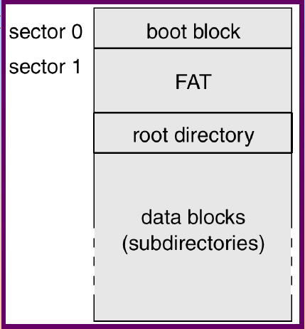
MS-DOS Disk Layout

Slide 31
Bad Blocks
IDE
  MS-DOS format : write a special value into the corresponding FAT entry for bad blocks
  MS-DOS chkdsk : search and lock bad blocks

Slide 32
Bad Blocks – SCSI(Small Computer System Interface) (Cont.)
Controller maintains a list of bad blocks on the disk
Low-level formatting → spare sectors (OS don’t know)
Controller replaces each bad sector logically with one of the spare sectors (sector sparing, or forwarding)
  Invalidate optimization by OS’s disk scheduling
  Each cylinder has a few spare sectors

Slide 33
Bad Blocks – SCSI (Cont.)
Typical bad-sector transaction
  OS tries to read logical block 87
  Controller calculates ECC and finds that it is bad. Report to OS
  Reboot next time, a special command is run to tell the controller to replace the bad sector with a spare.
  Whenever the system requests block 87, it is translated into the replacement sector’s address by the controller
Sector slipping:
  Ex. Let sector 17 defective and first spare follows sector 202
    Spare ← 202 ← 201 ← … ←18 ← 17

Slide 34
Read Errors
After reading a sector, what if ECC indicates an error
  ECC may allow error correction
  Read again, and error may go away
  If read error seems to happen repeatedly, then the sector can be marked as bad, and replaced by a spare sector
Instead of the driver, OS may need to keep track of bad sectors
Backups have to worry about bad sectors

Slide 35
Reliability by Redundancy
Mirroring (or Shadowing): duplicate disks
Write every block to both the disks
Read can be performed from any of the two disks
  This can be exploited to allow parallelism and speeding up of reads
  Also for error correction: if first read fails, try the other
Crash: If one disk crashes, then the other one can be used to restore data
If failures are independent, this dramatically increases mean- time to failure
This can be managed by device driver (if it can handle multiple disks) or by OS
Duplicating a disk is expensive.

Slide 36
RAID
Redundant Array of Independent Disks
RAID (redundant array of independent disks) is a way of storing the same data in different places on multiple hard disks or solid-state drives to protect data in the case of a drive failure. There are different RAID levels, however, and not all have the goal of providing redundancy.
Disk access times are still slow compared to CPU/memory
Natural solution: Read concurrently from multiple disks
RAID Controller talks to OS just like a device driver and manages a suite of disks to improve reliability and performance

Slide 37
Key evaluation points for a RAID System
Reliability: How many disk faults can the system tolerate?
Availability: What fraction of the total session time is a system in uptime mode, i.e. how available is the system for actual use?
Performance: How good is the response time? How high is the throughput (rate of processing work)? Note that performance contains a lot of parameters and not just the two.
Capacity: Given a set of N disks each with B blocks, how much useful capacity is available to the user?

Slide 38
RAID levels
Raid devices will make use of different versions, called levels. The original paper that coined the term and developed the RAID setup concept defined six levels of RAID -- 0 through 5. This numbered system enabled those in IT to differentiate RAID versions. The number of levels has since expanded and has been broken into three categories: standard, nested and nonstandard RAID levels.

Slide 39
RAID 0
Array of disks with block-level striping
Strip = k sectors (for suitably chosen k)
First k sectors are on first strip of first disk, next k sectors are on first strip of second disk, and so on
Advantages:
  A large request spanning multiple strips can be parallelized easily
  Not much overhead
  Used in high-performance applications
Disadvantages
  No redundancy
  Mean-time to failure is, in fact, less than standard disks (why?)
  No parallelism for small requests

Slide 40
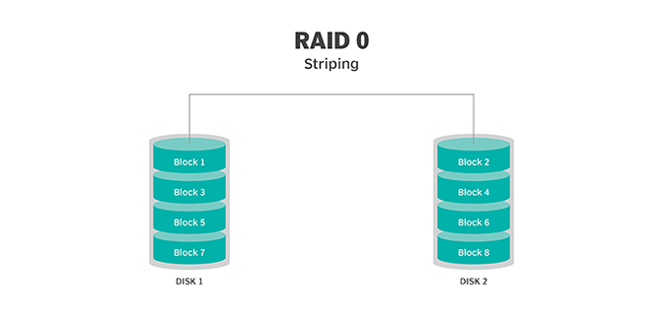
RAID 0

Slide 41
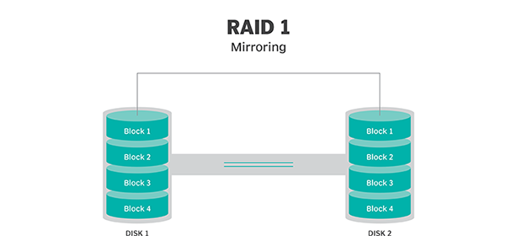
RAID 1
Like mirroring, but with striping of level 0
Use same number of backup disks with same striping
Same benefits/issues as in mirroring

Slide 42
RAID 2
Called memory-style error correcting code organization
Uses bit-level striping
Some of the bits used for parity or other error correction
Sample: 4-bits of data encoded by additional 3-bits of ECC, and resulting 7 bits stored on 7 different disks
CM-2 machine: 32-bits of data with 7-bits of ECC spanning over array of 39 disks
Advantages
  Great parallelism for read as well as write
  Even if one disk crashes, all data can be recovered (due to ECC)
Disadvantages
  Drives have to synchronized
  Overhead in putting together reads from different disks
  Crash recovery much slower (compared to RAID-1)

Slide 43
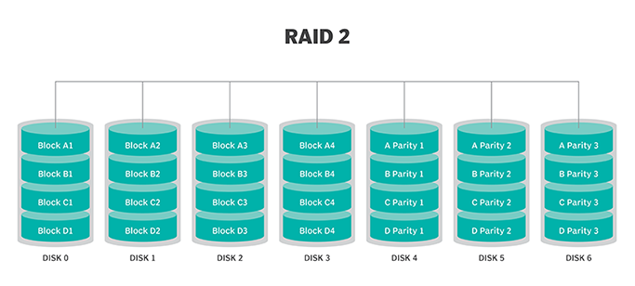
RAID 2

Slide 44
RAID 3
This technique uses striping and dedicates one drive to storing parity information.
The embedded ECC information is used to detect errors.
Data Recovery is accomplished by calculating the exclusive information recorded on the other drives.
Advantage
  Best for single-user systems with long record applications.
Disadvantage
  Since an I/O operation addresses all the drives at the same time, RAID 3 cannot overlap I/O.

Slide 45
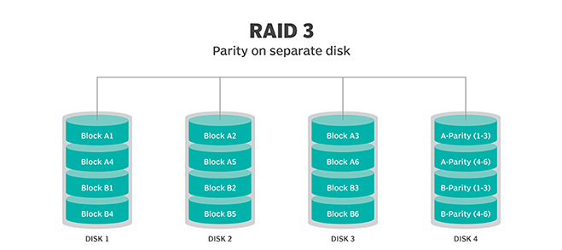
RAID 3

Slide 46
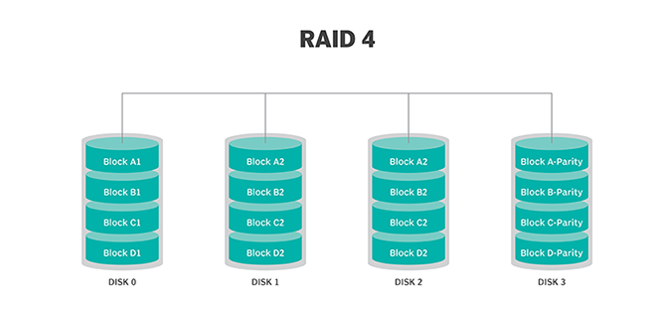
RAID 4
This level uses large stripes.
User can read records from any single drive.
Overlapped I/O can then be used for read operations.
Since all write operations are required to update the parity drive, no I/O overlapping is possible.

Slide 47
RAID 5
This level is based on parity block-level striping.
The parity information is striped across each drive, enabling the array to function even if one drive were to fail.
Advantage
  The array's architecture allows read and write operations to span multiple drives -- resulting in performance better than that of a single drive.
Disadvantage
  Performance is not as high as that of a RAID 0 array.
  Considered to be a poor choice for use on write-intensive systems because of the performance impact associated with writing parity data.
  When a disk fails, it can take a long time to rebuild a RAID 5 array.

Slide 48
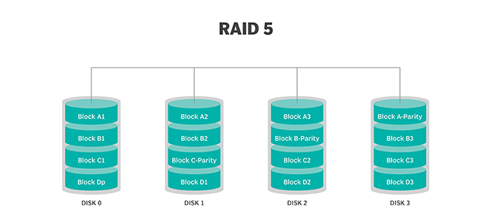
RAID 5

Slide 49
Advantage of RAID
An improvement in cost-effectiveness because lower-priced disks are used in large numbers.
The use of multiple hard drives enables RAID to improve on the performance of a single hard drive.
Increased computer speed and reliability after a crash -- depending on the configuration.
Reads and writes can be performed faster than with a single drive with RAID 0. This is because a file system is split up and distributed across drives that work together on the same file.
There is increased availability and resiliency with RAID 5. With mirroring, RAID arrays can have two drives containing the same data, ensuring one will continue to work if the other fails.

Slide 50
Disadvantage of RAID
Nested RAID levels are more expensive to implement than traditional RAID levels because they require a greater number of disks.
The cost per gigabyte of storage devices is higher for nested RAID because many of the drives are used for redundancy.
When a drive fails, the probability that another drive in the array will also soon fail rises, which would likely result in data loss.
Some RAID levels (such as RAID 1 and 5) can only sustain a single drive failure.
RAID arrays, and the data in them, are in a vulnerable state until a failed drive is replaced and the new disk is populated with data.

Slide 51
Swap-space Management

Slide 52
Swap-Space Use
Part of memory used as virtual memory space
More swap memory reserved, may waste the memory
Less swap space may abort a process
In Linux normally swap pace was kept double of the physical memory, but now days it is a topic of debate in Linux community

Slide 53
Swap-Space Location
A swap space can reside in one of two locations:
  As a normal file system
    easy, but inefficient (time consuming)
    External fragmentation
  In a separate disk partition
    Swap space storage manager is used to allocate and deallocate the memory
    Designed to improve speed rather storage
    internal fragmentation
  Mixed scheme

